Slide 1
Online Retailer
302CEM – Midpoint Submission
Chan Hon Lam, Harris
Lau Moon Ho, Kelvin
Lui Cheuk Hin, Vincent
Lui Chun Wang, Winko
Hui Ho Wa, Philip

Slide 2
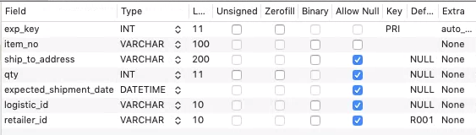
Export CSV File to Logistic Team
Table Structure
Database Link
http://59.148.6.210/pma

Slide 3
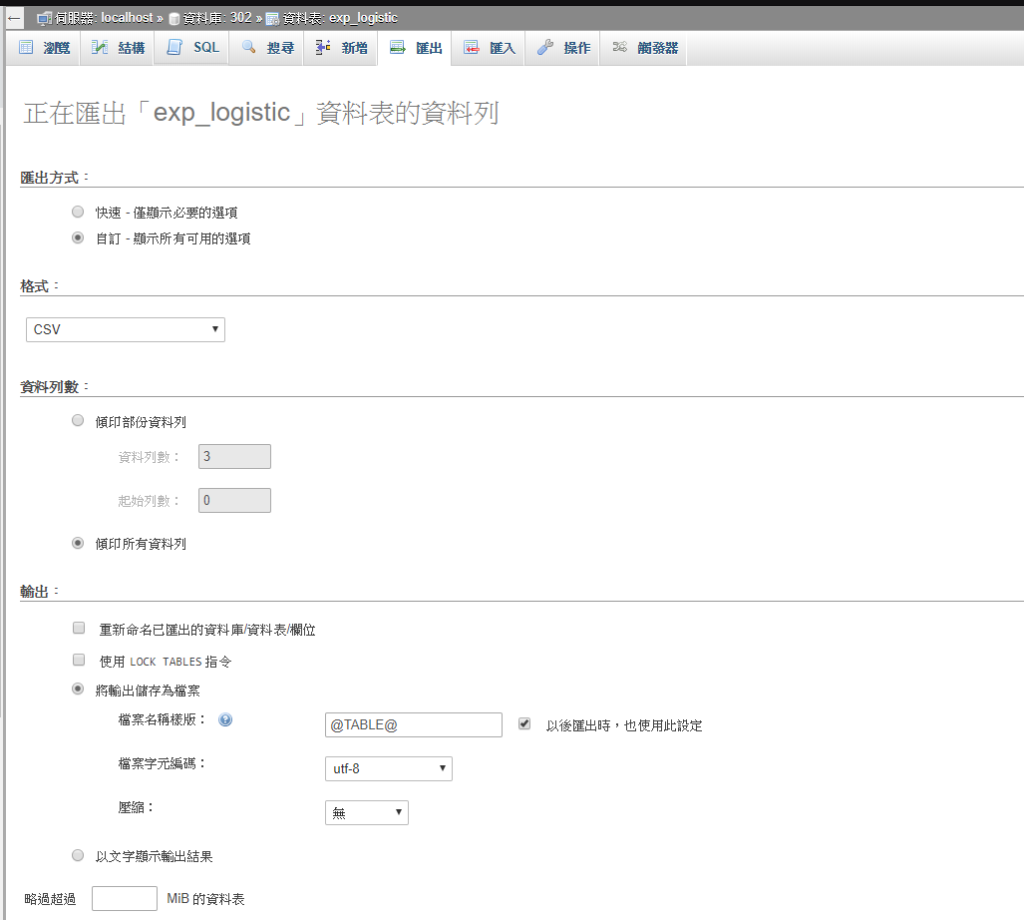
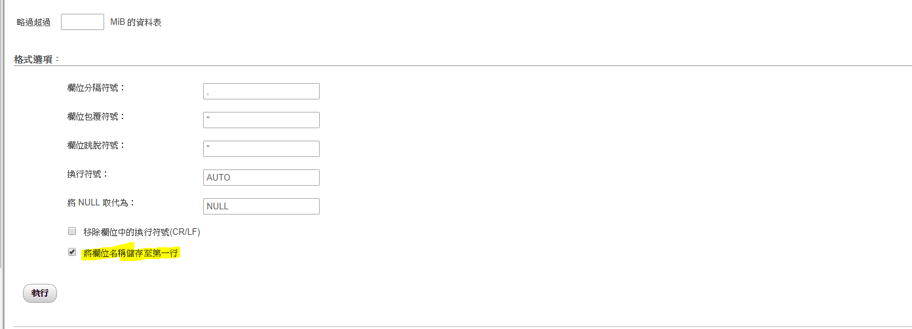
Export Setting in PhpMyAdmin

Slide 4

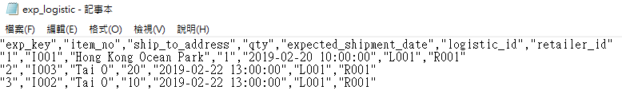
Export Json File to Logistic Team
Sample Data
Output

Slide 5
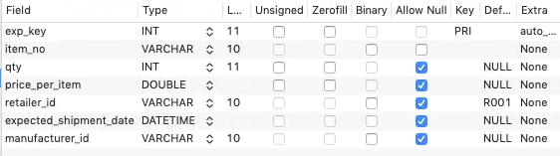
Export Json File to Manufacturer Team
Table Structure

Slide 6
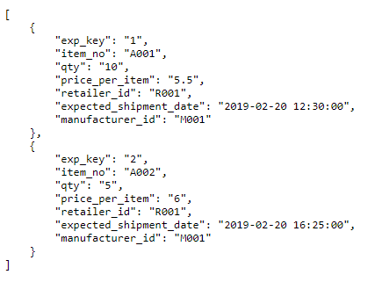
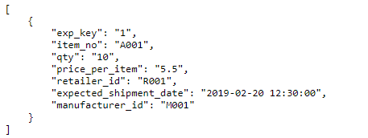
Export Json File to Manufacturer Team
Output
https://302.winkoxd.com/manufacturer.php (Generate All Live Database Data)
https://302.winkoxd.com/manufacturer.php?expKey=1 (Generate Specific row)

Slide 7
Agile project planning
Agile project planning

Slide 8
End of Midpoint Submission

Slide 9
Project Charter
Project Name: Organic Food Online Stores
Project Champion: Complete Web System and send EDI request to logistic and manufacturer team
Project Sponsor: n/a
Project Manager: Philip Hui
Stakeholder: Logistic Team, Manufacturer Team, Online Retailer Team
Expected Start Date: 1 Mar, 2019
Expected End Date: 1 Apr, 2019

Slide 10
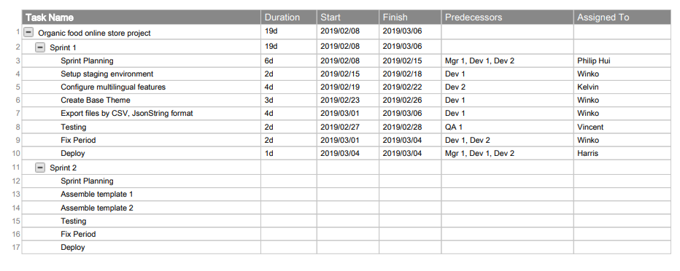
Project Plan

Slide 11
Agile Product Backlog

Slide 12
Sprint Backlog

Slide 13
Test Plan

Slide 14
Release Plan

